Slide 1
MapReduce

Slide 2
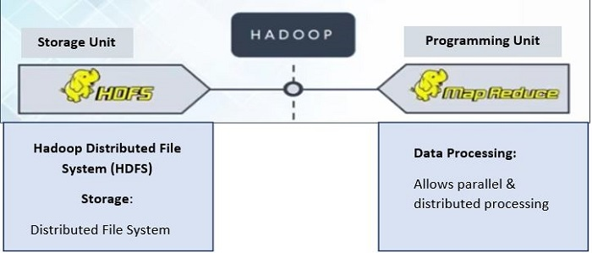
Main Hadoop Components

Slide 3
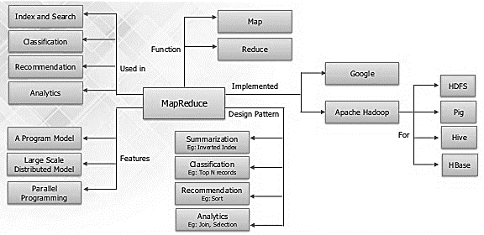
MapReduce

Slide 4
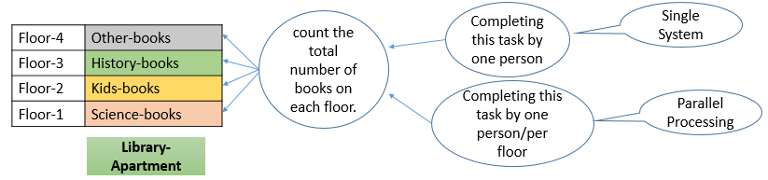
MapReduce Analogy
Library that has an extensive collection of books that live on several floors.
Parallel processing refers to using multiple machines that contribute their RAM and CPU for data processing. This is the concept of the Hadoop framework, where you not only store data across different machines, but you can also process the data locally.
Student must be know about:
Big Data
Hadoop

Slide 5
MapReduce: What It Is and Why It Is Important
Hadoop and spark, that works in the network of computers in parallel to find solutions to Big Data and process it using the MapReduce algorithm.
MapReduce is a Distributed Data Processing Algorithm, introduced by Google in it’s MapReduce Tech Paper (2004).
MapReduce algorithm is mainly useful to process huge amount of data in parallel, reliable and efficient way in cluster environments.
This became the origin of the Hadoop Processing Model.
MapReduce is a programming model that allows us to perform parallel and distributed processing on huge data sets.

Slide 6
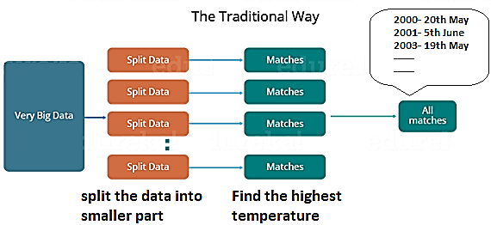
Distributed processing (Traditional way)
Before we understand MapReduce, when the MapReduce framework was not there, how parallel and distributed processing used to happen in a traditional way.
let us take an example:
We have a weather dataset containing the daily average temperature of the years from 2000 to 2018.
Query: want to calculate the day having the highest temperature in each year.
In traditional way:

Slide 7
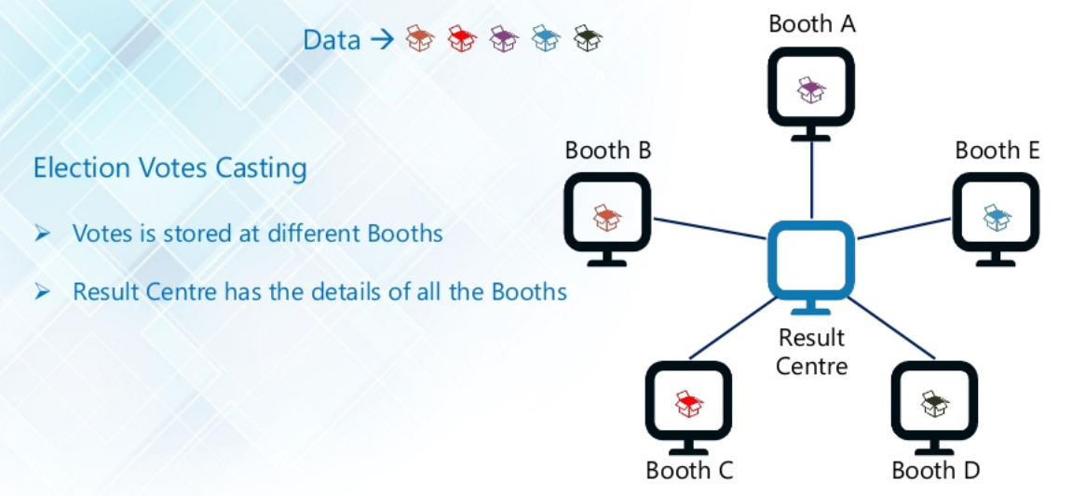

Slide 8
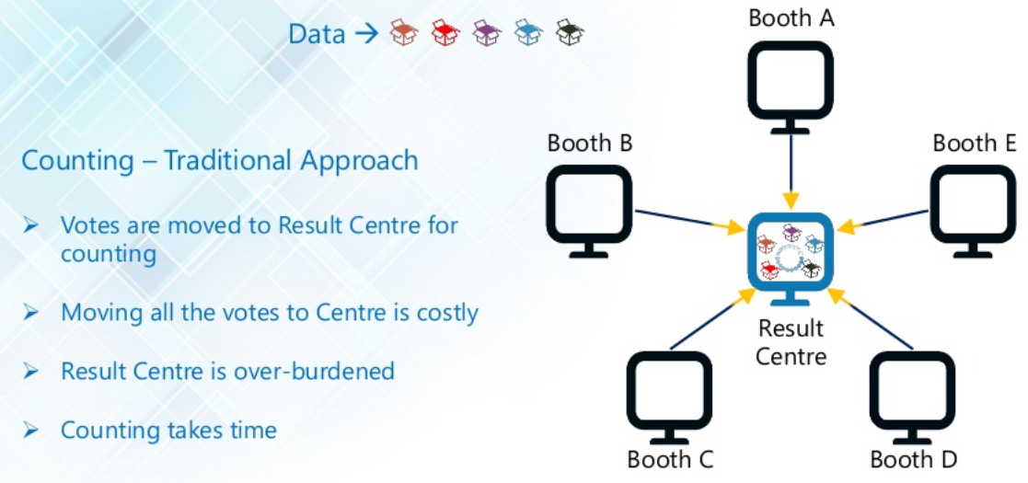

Slide 9
Distributed processing (Traditional way)
Let us look at the challenges associated with this traditional approach:
If, any of the machines delay the job, the whole work gets delayed (Critical path problem).
What if, any of the machines which are working with a part of data fails? The management of this failover becomes a challenge (Reliability problem).
how to equally divide the data such that no individual machine is overloaded or underutilized (Equal split issue).
There should be a mechanism to aggregate the result generated by each of the machines to produce the final output (Aggregation of the result).
These are the issues which we will have to take care individually while performing parallel processing of huge data sets when using traditional approaches.
To overcome these issues, we have the MapReduce framework which allows us to perform such parallel computations without bothering about the issues like reliability, fault tolerance etc.

Slide 10
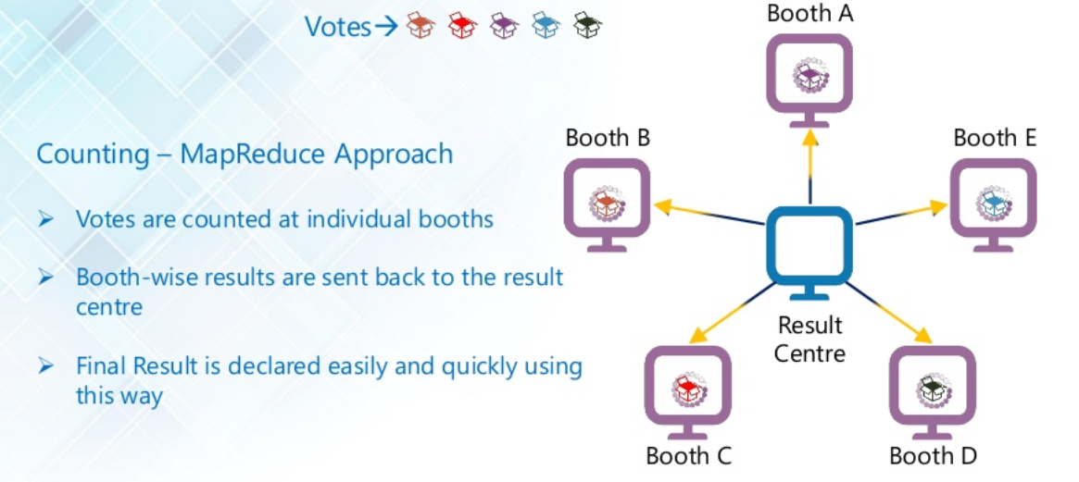

Slide 11

What is MapReduce?
MapReduce is the process of taking a list of objects and running some operations over each object in the list (i.e., map) to either produce a new list or calculate a single value (i.e., reduce).
Example:
(Ford, Ford, Ford, Mazda, Chevrolet, Chevrolet) //car sold by car dealer
Map: ((Ford, 1), (Ford, 1), (Ford, 1), (Mazda,1), (Chevrolet, 1), (Chevrolet, 1)) //add 1
Reduce: ((Ford, 3), (Mazda,1), (Chevrolet, 2) //places similar item together
Now we can read car sales by manufacturer.

Slide 12
MapReduce Algorithm uses the following three main steps:
Map Function
Shuffle Function
Reduce Function
Advantages of Map Reduce
MapReduce is useful for batch processing on terabytes or peta bytes of data stored in Apache Hadoop.

Slide 13
Map Function
Map Function is the first step in MapReduce Algorithm.
It takes input task(say DataSets) and divides them into smaller sub-tasks.
Then perform required computation on each sub-task in parallel.
Means, Map Function performs the following two sub-steps:
Splitting (takes input DataSet from Source and divide into smaller Sub-DataSets)
Mapping (takes smaller Sub-DataSets and perform required computation on each Sub-DataSet.)
The output of this Map Function is a set of key and value pairs as <Key, Value> as shown in the figure.

Slide 14
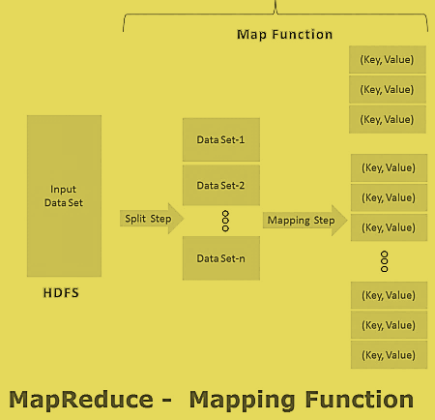
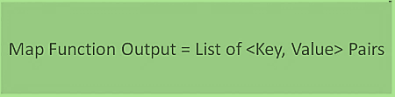
MapReduce First Step Output:

Slide 15
Shuffle Function
It is the second step in MapReduce Algorithm. Shuffle Function is also know as “Combine Function”.
It takes a list of outputs coming from “Map Function” and perform following two sub-steps on each and every key-value pair.
Merging: this step combines all key-value pairs which have same keys (that is grouping key-value pairs by comparing “Key”). This step returns <Key, List<Value>>.
Sorting: this step takes input from Merging step and sort all key-value pairs by using Keys. This step also returns <Key, List<Value>> output but with sorted key-value pairs.
Finally, Shuffle Function returns a list of <Key, List<Value>> sorted pairs to next step.

Slide 16
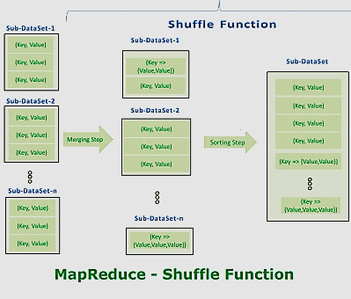

MapReduce Second Step Output:

Slide 17
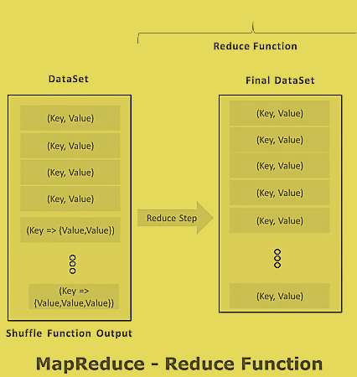

Reduce Function
It is the final step in MapReduce Algorithm. It performs only one step : Reduce step.
It takes list of <Key, List<Value>> sorted pairs from Shuffle Function and perform reduce operation as shown below.
MapReduce Final Step Output:
Final step output looks like first step output.
However final step <Key, Value> pairs are different than first step <Key, Value> pairs.
Final step <Key, Value> pairs are computed and sorted pairs.

Slide 18
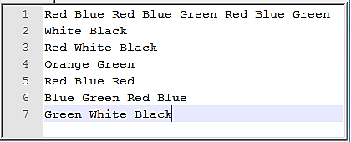
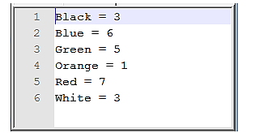
MapReduce Example – Word Count
Problem Statement:
Count the number of occurrences of each word available in a DataSet.
Input DataSet:
Client Required Final Result:

Slide 19
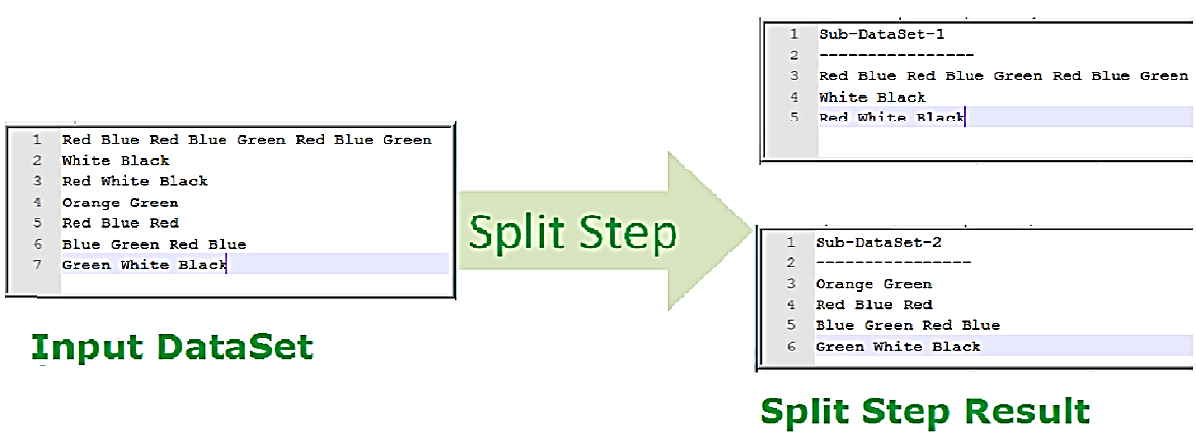
MapReduce – Map Function (Split Step)

Slide 20
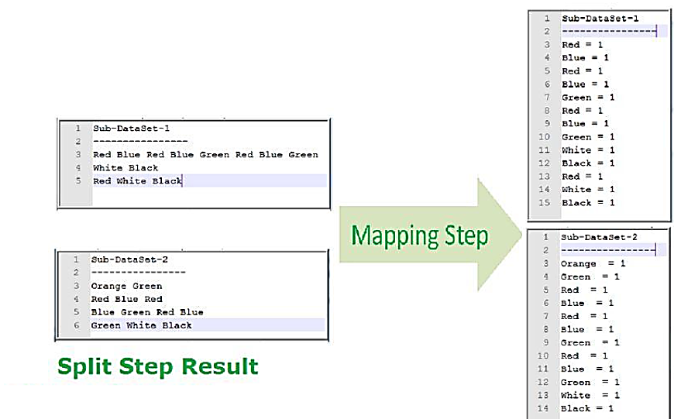
MapReduce – Map Function (Mapping Step)

Slide 21
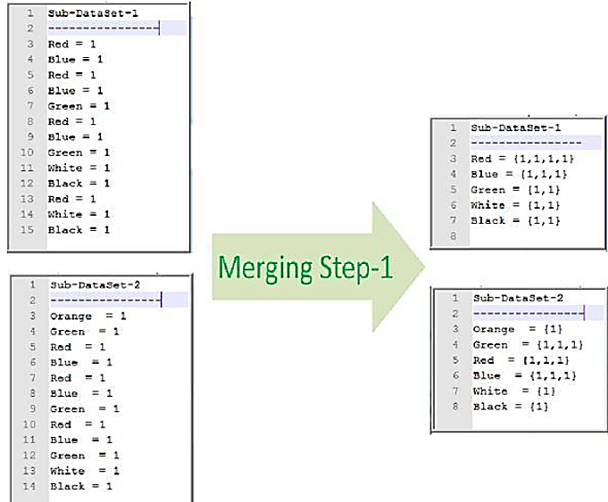
MapReduce – Shuffle Function (Merge Step)

Slide 22
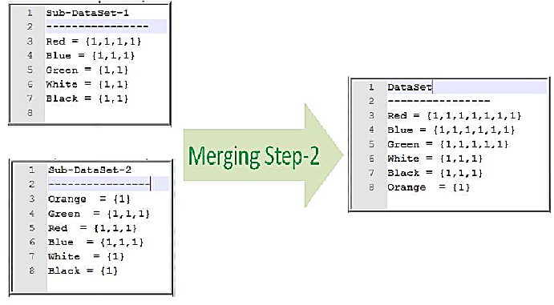
MapReduce – Shuffle Function (Merge Step)

Slide 23
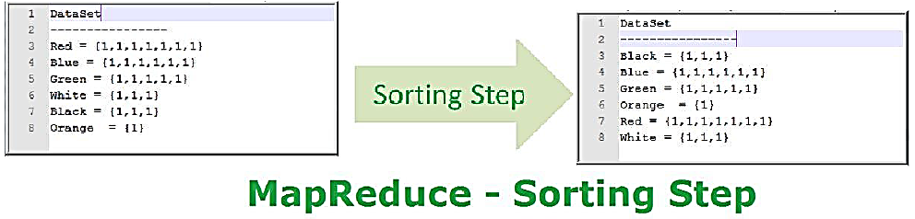
MapReduce – Shuffle Function (Sorting Step)

Slide 24
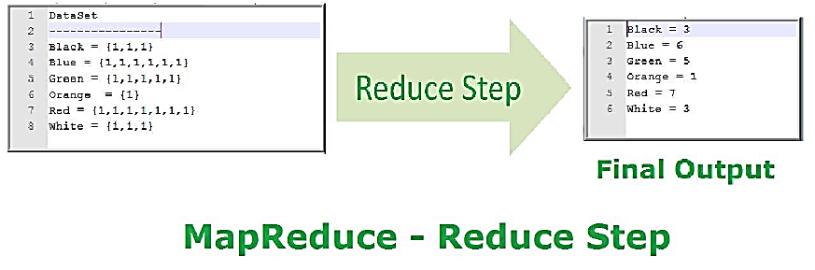
MapReduce – Reduce Function (Reduce Step)

Slide 25
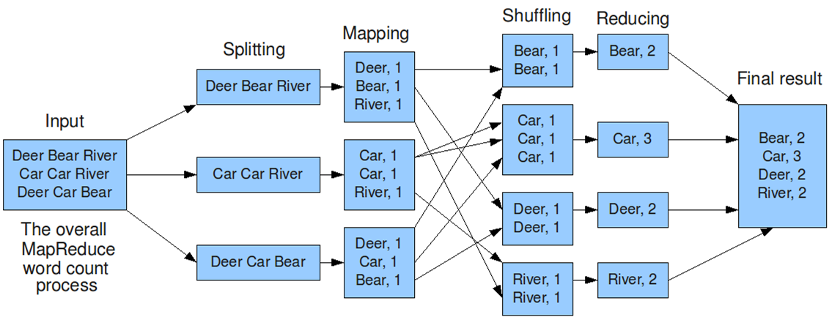
Example-2

Slide 26
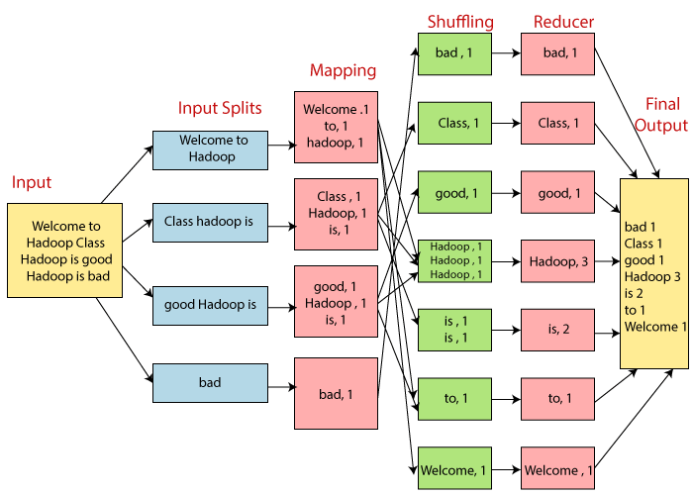
Example-3

Slide 27
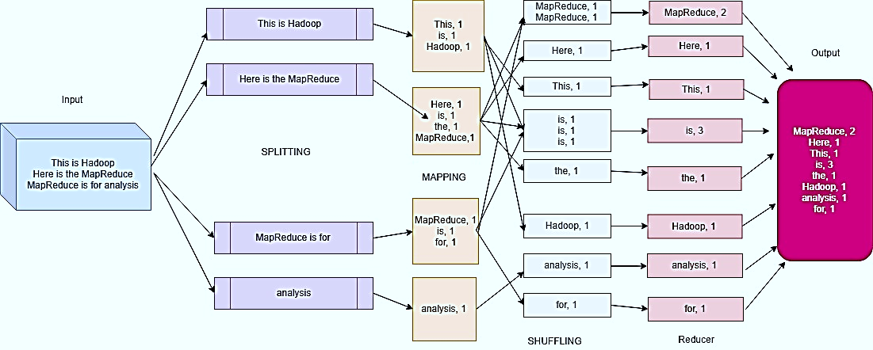
Example-4

Slide 28
How MapReduce Work ?
From start to finish, there are four fundamental transformations.
Data is :
1. Transformed from the input files and fed into the mappers.
2. Transformed by the mappers.
3. Sorted, merged, and presented to the reducer.
4. Transform by reducers and written to output files.
Most of the computing takes place on nodes with data on local disks that reduces the network traffic.
After completion of the given tasks, the cluster collects and reduces the data to form an appropriate result, and sends it back to the Hadoop server.

Slide 29
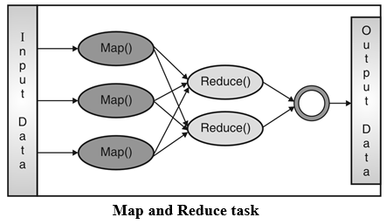
How MapReduce Work ?

Slide 30
MapReduce: Inputs and Outputs
Input and Output types of a MapReduce job :
(Input) <k1, v1>
Map
<k2, v2>
Reduce
<k3, v3> (Output)
 | Input | Output
Map | <k1, v1> | list (<k2, v2>)
Reduce | <k2, list(v2)> | list (<k3, v3>)

Slide 31
Map and Reduce Phases:
Map task is broken into following phases:
RecordReader
Mapper
Combiner
Partitioner
Reducer task is broken into following phases:
Shuffle
Sort
Reducer
O/P format

Slide 32
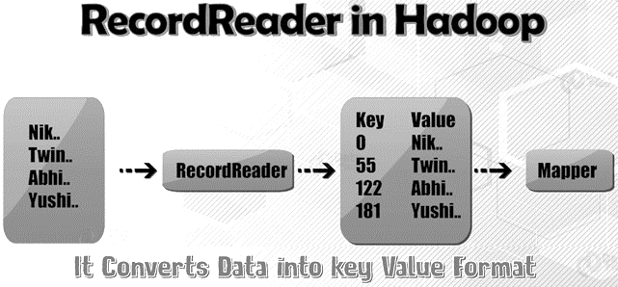
Map and Reduce Phases:
Map task is broken into following phases:
RecordReader
Convert the byte-oriented view of input into record-oriented view for Mapper task.
It present the tasks with keys and values.
Generally the key is the positional information and value is a chunk of data that contain the record.

Slide 33
Map and Reduce Phases:
Map task is broken into following phases:
Mapper
Map function works on the key-value pair produced by RecordReader and generate zero or more intermediate key-value pairs.
Combiner
It is optional function but provide high performance in terms of n/w bandwidth and disk space.
Like map output in some stage is <1,10>, <1,15>, <1,20>, <2,5>, <2,60> and the purpose of map-reduce job is to find the maximum value corresponding to each key. In combiner you can reduce this data to <1,20> , <2,60> as 20 and 60 are maximum value for key 1 and key 2 respectively.
It is an optimization technique for MapReduce Job.
Output generated by combiner is intermediate data and it is passed to the reducer.

Slide 34
Map and Reduce Phases:
Map task is broken into following phases:
Partitioner
It happens after map phase and before reduce phase.
Map task returns output in <key,value> form.
For many of the outputs key can be same.
Example:
If map output is <1,10> , <1,15> , <1,20> , <2, 13> , <2,6> , <4,8> , <4,20> etc.
We can see that there are 3 different keys which are 1, 2 and 4.
In map-reduce number of reduce tasks are fixed and each reduce task should handle all the data related to one key.
That means map output like <1,10>, <1,15>, <1,20> should be handled by same reduce tasks.
It is not possible that <1,10> is handled by one reduce task and <1,15> is handled by another reduce task as key which is 1 is same.
Partitioning is to club the data which should go to the same reducer based on keys.

Slide 35
Map and Reduce Phases:
Reducer task is broken into following phases:
Shuffle and Sort
Reducer
O/P format

Slide 36
MapReduce Architecture explained in detail
One map task is created for each split which then executes map function for each record in the split.
Execution of map tasks results into writing output to a local disk on the respective node and not to HDFS.
Map output is intermediate output which is processed by reduce tasks to produce the final output.
Once the job is complete, the map output can be thrown away. So, storing it in HDFS with replication becomes overkill.

Slide 37
MapReduce Architecture explained in detail
In the event of node failure, before the map output is consumed by the reduce task, Hadoop reruns the map task on another node and re-creates the map output.
Reduce task doesn't work on the concept of data locality. An output of every map task is fed to the reduce task. Map output is transferred to the machine where reduce task is running.
On this machine, the output is merged and then passed to the user-defined reduce function.
Unlike the map output, reduce output is stored in HDFS (the first replica is stored on the local node and other replicas are stored on off-rack nodes). So, writing the reduce output

Slide 38
Terminology used in Map Reduce
Pay Load | Applications implement the Map and the Reduce functions, and form the core of the job.
Mapper | Mapper maps the input key/value pairs to a set of intermediate key/value pair.
Named Node | Node that manages the Hadoop Distributed File System (HDFS).
DataNode | Node where data is presented in advance before any processing takes place.
Master Node | Node where JobTracker runs and which accepts job requests from clients.
Slave Node | Node where Map and Reduce program runs.
Job Tracker | Schedules jobs and tracks the assign jobs to Task tracker.
Task Tracker | Tracks the task and reports status to JobTracker.
Job | A program is an execution of a Mapper and Reducer across a dataset.
Task | An execution of a Mapper or a Reducer on a slice of data.
Task Attempt | A particular instance of an attempt to execute a task on a SlaveNode.

Slide 39
How MapReduce Organizes Work?
Hadoop divides the job into tasks. There are two types of tasks:
Map tasks (Splits & Mapping)
Reduce tasks (Shuffling, Reducing)
The complete execution process (execution of Map and Reduce tasks, both) is controlled by two types of entities:
JobTracker:
Acts like a single master (responsible for complete execution of submitted job)
Task Trackers:
Acts like one slaves/Cluster Node, each of them performing the job as directed by the master.
For every job submitted for execution in the system, there is one Jobtracker that resides on Namenode and there are multiple tasktrackers which reside on Datanode.

Slide 40
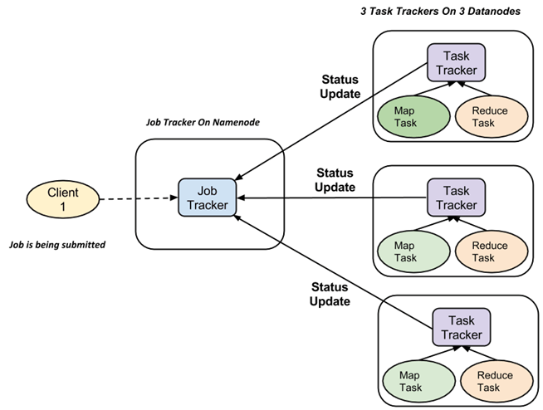
How MapReduce Organizes Work?

Slide 41
How MapReduce Organizes Work?
A job is divided into multiple tasks which are then run onto multiple data nodes in a cluster.
It is the responsibility of job tracker to coordinate the activity by scheduling tasks to run on different data nodes.
Execution of individual task is then to look after by task tracker, which resides on every data node executing part of the job.
Task tracker's responsibility is to send the progress report to the job tracker.
In addition, task tracker periodically sends 'heartbeat' signal to the Jobtracker so as to notify him of the current state of the system.
Thus job tracker keeps track of the overall progress of each job. In the event of task failure, the job tracker can reschedule it on a different task tracker.

Slide 42
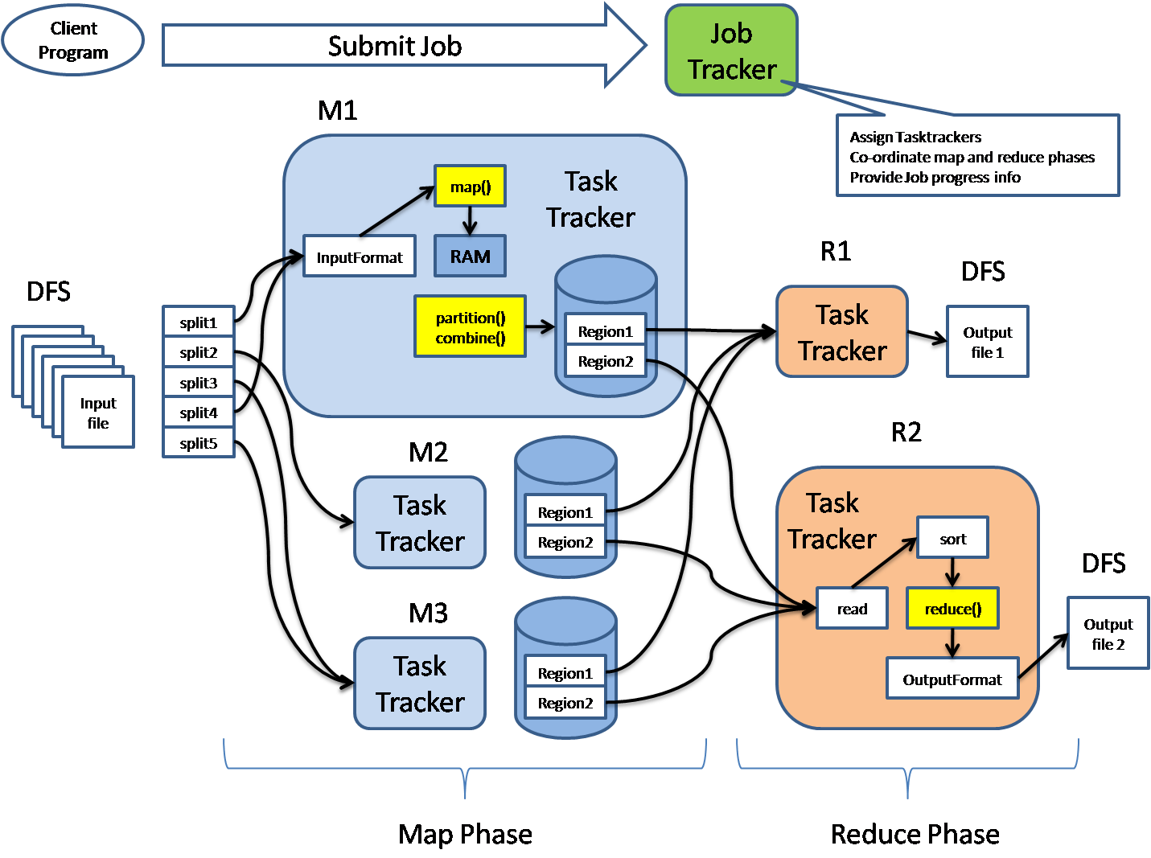
Hadoop Map Reduce Architecture

Slide 43
MapReduce key benefits
Benefit | Description
Simplicity | Developers have freedom to write applications in their language of choice, such as Java, C++ or Python, and MapReduce jobs are easy to run.
Scalability | MapReduce can process huge amount of data (in terms of petabytes and more) , stored in HDFS on one cluster
Speed | It uses parallel processing it means that MapReduce can take problems that used to take days to solve which can be solved in hours or minutes
Recovery | MapReduce also takes care of failures. If a machine with one copy of the data is unavailable than another machine has a copy of the same key/value pair, which can be used to solve the same sub-task. The JobTracker keeps track of these all processes.
Minimal data motion | MapReduce moves are able to compute processes to the data on HDFS and not the other way around. Processing tasks can occur on the physical node where the data resides. This significantly reduces the network I/O patterns and contributes to Hadoop’s processing speed.

Slide 44
Business and other organizations run calculations to:
Determine the price for their products that yields the highest profits.
Know precisely how effective their advertising is and where they should spend their ad dollars.
Make long-range weather predictions.
Web clicks, sales records purchased from retailers, and Twitter trending topics to determine what new products the company should produce in the upcoming season.

Slide 45
MapReduce Use Case: Global Warming
Query: we want to know how much global warming has raised the ocean’s temperature.
We have input temperature readings from thousands of OceanSignals all over the globe. We have data in this format:
(OceanSignals, DateTime, longitude, latitude, lowTemp, highTemp)
The first would be to run a map over every OceanSignals -dateTime reading and add the average temperature as a field:
(OceanSignals, DateTime, longitude, latitude, lowTemp, highTemp, Average)
Drop DateTime column and produce one average temperature for each OceanSignals
(OceanSignal N, Average) //like, (OceanSignal 1, Average) , (OceanSignal 2, Average)
Then the reduce operation runs.
Ocean Average Temperature = Average (OceanSignal n) + Average (OceanSignal n-1) + … + Average (OceanSignal 2) + Average (OceanSignal 1) / number of OceanSignals

